Slide 1


Capstone Project 2 - Bank Marketing Prediction (Imbalanced Classification with SMOTE) Kevin Chen
Thanks to Springboard mentors: Kevin

Slide 2
Why Term Deposits Are Important for Banks
Provide stable, long-term funding (unlike regular savings accounts)
Create predictable future cash flows
Serve as a low-risk source of capital
Help banks retain customers for longer periods
Why Term Deposits Are Important for Banks
Provide stable, long-term funding (unlike regular savings accounts)
Create predictable future cash flows
Serve as a low-risk source of capital
Help banks retain customers for longer periods

Slide 3

Business Problem & Goal Portuguese Bank Marketing Campaign (UCI)
Direct marketing by phone is costly and time-consuming
Only a small fraction of clients subscribe to a term deposit (strong class imbalance)
Goal: predict which clients are likely to subscribe so that the bank can prioritize them

Slide 4
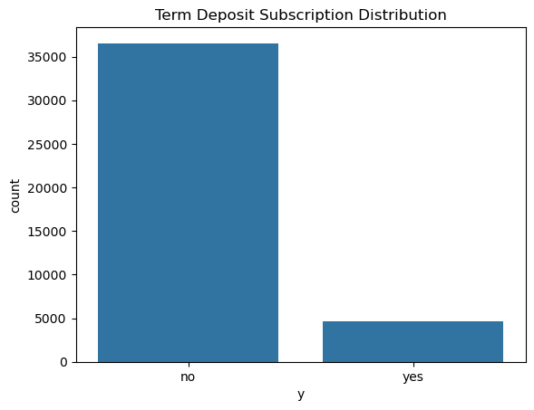
Data Overview
Source: UCI Bank Marketing Dataset (Portuguese bank)
41,188 rows; >20 features (demographic, contact history, economic indicators)
Target variable: y (term deposit subscription: yes / no)
Strongly imbalanced target:
no - 88.73%
Yes – 11.27%

Slide 5
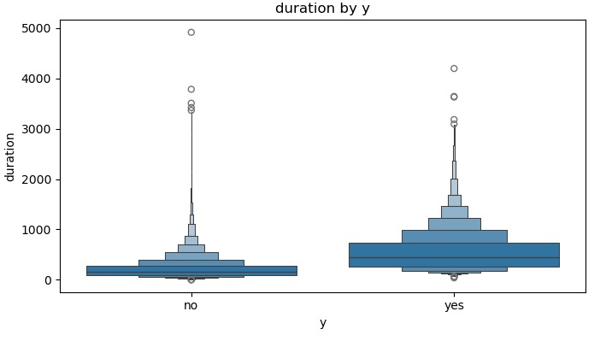
Duration vs Target (y)
Longer call duration strongly associated with subscription

Slide 6
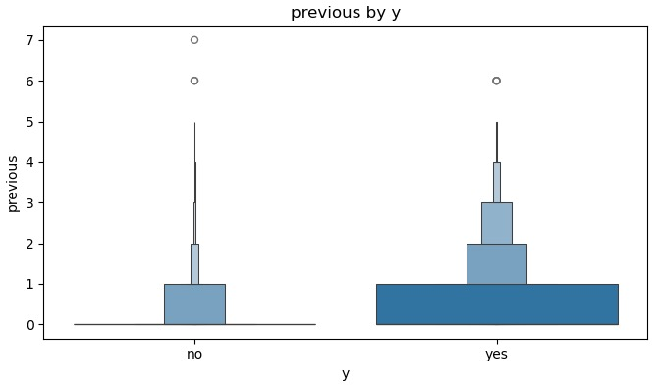
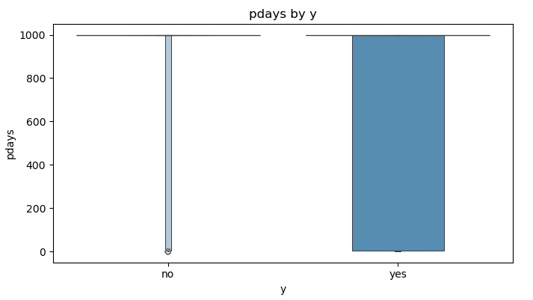
Previous/pdays vs Target (y)
Notes:
pdays vs y (target variable) — Simple Explanation
pdays tells us how many days passed since the last time the client was contacted in a previous marketing campaign.
pdays = 999 → The client has never been contacted before
Smaller pdays → The client was contacted more recently
What does the chart show?
Most clients who said “no” have pdays = 999, meaning they had no prior relationship with the bank
Clients who said “yes” have more varied pdays values, meaning they were contacted before, often not long ago
📌 Insight: Clients who have been contacted before (especially recently) are more likely to subscribe.
previous vs y (target variable) — Simple Explanation
previous tells us how many times the client was contacted in past campaigns.
previous = 0 → Never contacted before
previous > 0 → Has a history of receiving marketing calls
What does the chart show?
Most “no” clients have previous = 0
Many “yes” clients have previous > 0, meaning they had past engagement with the bank
📌 Insight: Customers with prior interactions (“warmer leads”) are far more likely to subscribe than new or “cold” customers.
Clients who have been contacted before (lower pdays or higher previous) show a much higher chance of subscribing compared to new or untouched clients.
Some economic variables (e.g., Euribor 3-month rate, employment variation) also correlated with subscription

Slide 7
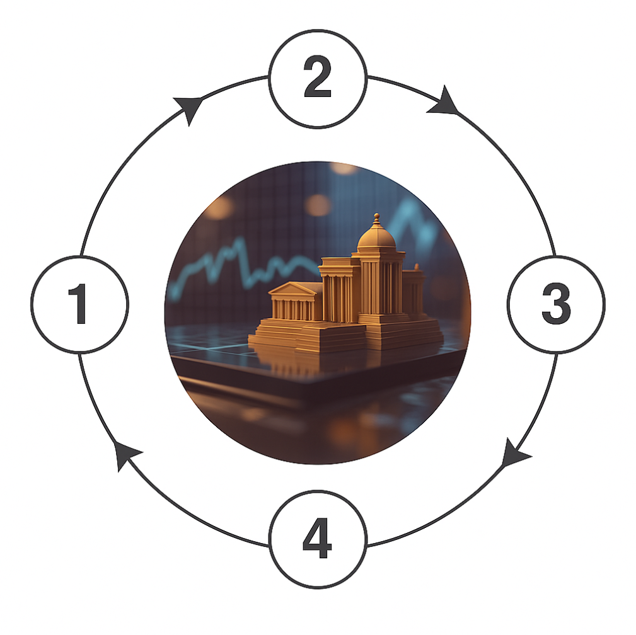
Modeling Strategy
Pipeline (training folds)
One-hot encode categorical features
Standardize numeric features
Apply SMOTE to oversample the minority class
Train–test split
80/20 with stratification
Evaluate with 5-fold Stratified Cross-Validation on the training set
Focus metrics
Recall, F1, ROC AUC (accuracy is misleading for imbalanced data)

Slide 8
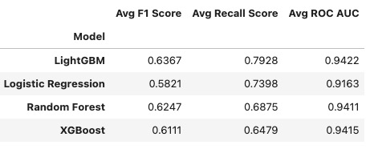
Models Compared
Notes:
I tested four models. Overall, LightGBM achieved the best balance across F1, recall, and AUC, slightly outperforming Random Forest and XGBoost, while Logistic Regression had good recall but lower F1 and AUC

Slide 9
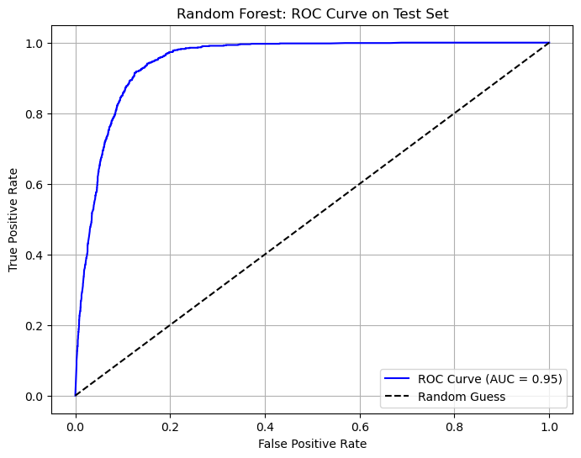
Final Model Performance LightGBM on Test Set
Precision ≈ 0.49
Recall ≈ 0.89
F1-score ≈ 0.63
ROC AUC ≈ 0.95
Confusion matrix: very low false negatives (many true subscribers correctly identified)
Notes:
Our model achieves a very high AUC of 0.95, meaning it can rank customers very well in terms of subscription likelihood.
However, Precision is relatively low because the dataset is highly imbalanced — only about 10% of customers subscribe.
The model intentionally prioritizes Recall to avoid missing potential subscribers, which aligns with the business goal: maximize campaign effectiveness by capturing as many true subscribers as possible.

Slide 10
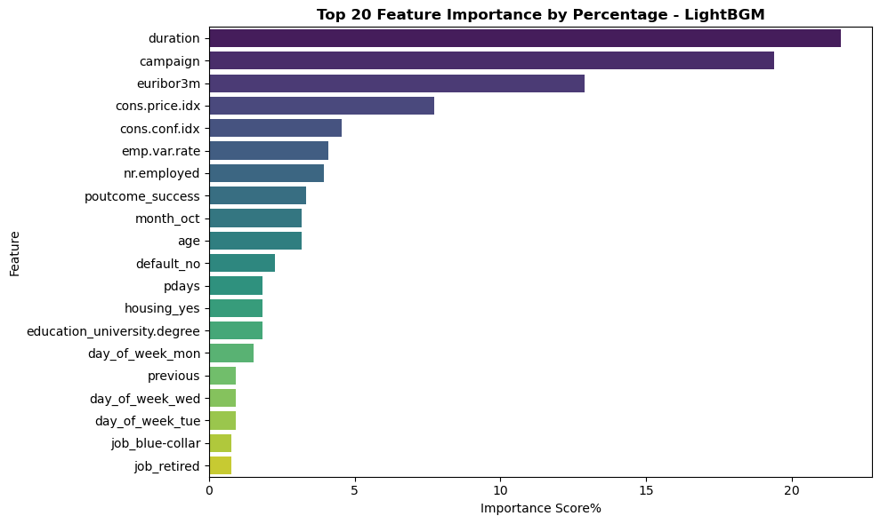
Feature Importance & Interpretation What Factors Matter Most?
Top features from LightGBM:
Call duration
Previous campaign outcome
Number of contacts in this campaign
Employment variation rate
Euribor 3-month rate
Notes:
Duration is by far the most important feature. Combined with previous outcomes and economic indicators, the model captures both customer engagement and broader market conditions.
These align with business intuition: richer interactions and favorable economic environments lead to higher subscription probability.
Importantly, the feature importance bar plot also confirms our initial EDA findings — showing that duration is highly correlated with subscription outcomes, validating both our early data visualization and the model’s learned patterns.

Slide 11
Business Recommendations
Prioritize high-score clients before launching campaigns (use model scores to generate call lists)
Focus on call quality, not only call volume – train agents to have longer, more meaningful conversations
Re-target clients with past positive responses or good engagement history
Consider integrating economic indicators into campaign planning (avoid calling during bad macro periods)
Notes:
Here are my main recommendations for the bank. First, prioritize high-scoring clients before launching campaigns. Second, focus on improving call quality — longer and more meaningful interactions tend to increase conversion. Third, re-target clients with positive prior engagement. And lastly, consider economic conditions when planning campaigns.
Instead of calling the entire customer list, the bank can use this model to rank clients and focus on the top segment — which helps reduce unnecessary calls and significantly improves campaign ROI.

Slide 12
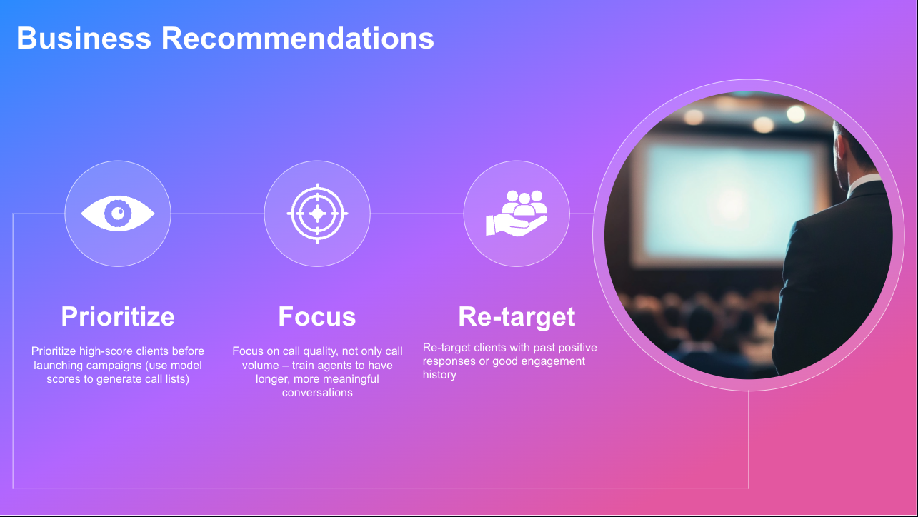

Slide 13
Limitations & Future Work
Adjust threshold 0.50/0.50
Ensemble sampling
SHAP
Business input → decision boundary

Slide 14





Thanks for your time
Capstone2 - Bank Marketing Campaign
Notes:
https://github.com/qchen077/Springboard/blob/main/Core_Courses/Feature_Engineering_/Capstone2_Bank_Marketing_Campaign.ipynb

